Slide 1
WELCOME
39th ANNUAL GENERAL MEETING
THURSDAY, JUNE 11TH, 2026
THE CANADIAN REGISTRATION BOARD OF OCCUPATIONAL HYGIENISTS
ROHTM – ROHTTM The Mark of Professional Competence

Slide 2
Welcoming Remarks
RULES OF CONDUCT OF MEETING
  Discussion via the chat function (moderator is Matthew Brewer).
  Only active members (ROH & ROHT) are entitled to submit questions and vote at the Meeting.
  Consensus decision making will be used.
  In the event of technical malfunction, the Chair of the Meeting may adjourn, recess, or expedite the Meeting.
  CRBOH will record the Meeting in the event a member has technical difficulties and is unable to join the meeting. Any other recording of the Meeting is prohibited.

Slide 3
AGENDA
3:40-3:50 Awards
3:50-3:55 New Business
- Incoming President
- New & Outgoing Directors
3:55-4:00 Members’ Discussion
4:00-4:05 Adjournment & Short Break
4:05-5:00 Presentation:
Leadership Driven Excellence -Transformational Leadership Drives H&S Excellence
Guest Speaker: Richard D. Fulwiler, ScD, CIH - Retired, FAIHA
3:00-3:05 Etiquette for Video Conference
3:00-3:05 Approval of Agenda
3:00-3:05 Approval of 2025 AGM Minutes
3:05-3:10 President’s Report
3:10-3:15 Vice President’s Report
3:15-3:20 Treasurer’s Report
3:20-3:25 Registrar’s Report
3:25-3:40 Committee Reports
      - External Affairs
      - Communication & Promotion
      - ROH/ROHT Examination
      - Registration Maintenance & Points
      - Future of the Profession

Slide 4
MOTION TO APPROVE THE AGENDA
Motion to approve the Agenda
Second to approve the Agenda

Slide 5
MOTION TO APPROVE THE 2025 MINUTES
Motion to approve the 2025 minutes
Second to approve the 2025 minutes

Slide 6
PRESIDENT’S REPORT
(3:05-3:10 pm)
KIET NGUYEN, ROH

Slide 7
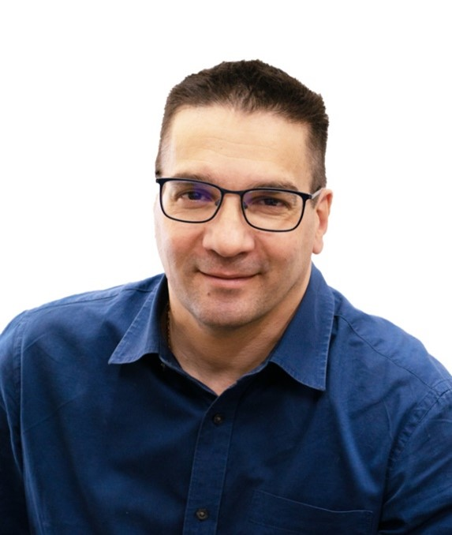
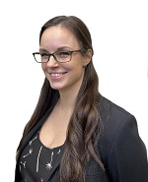
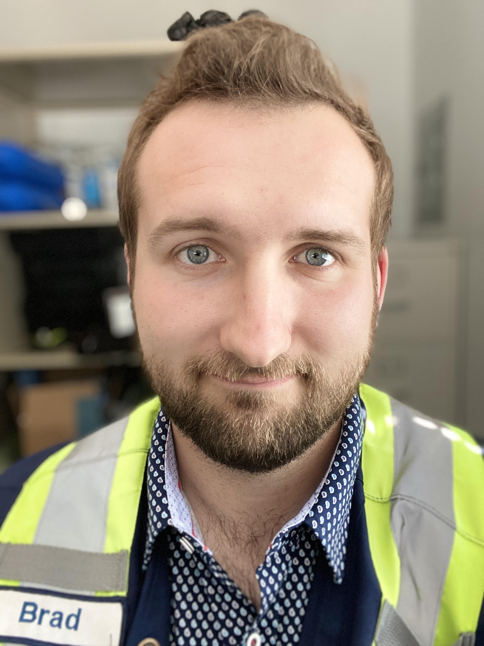
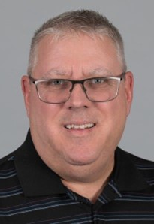
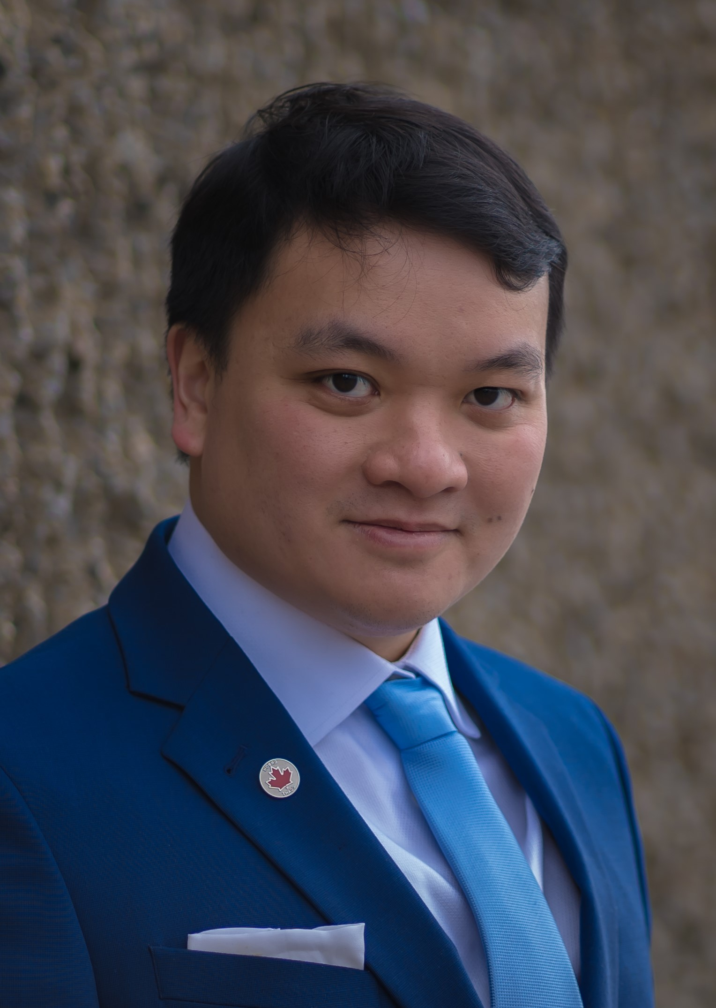

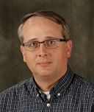
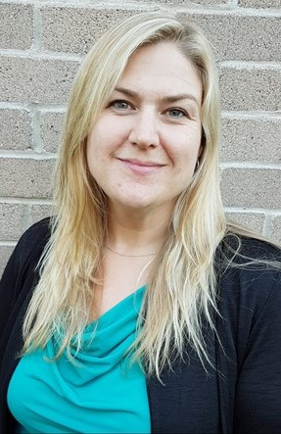
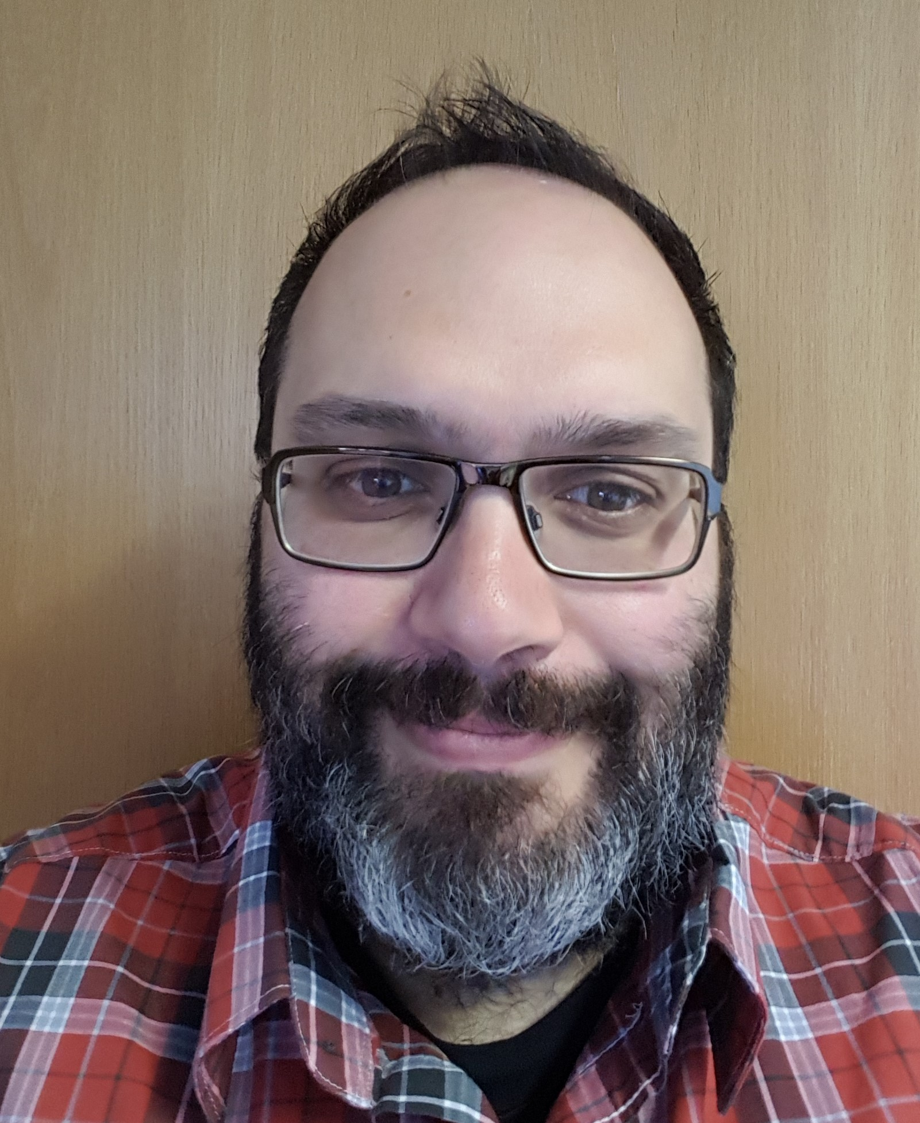
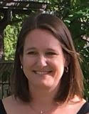
2025-2026 BOARD OF DIRECTORS
Joey Bellino
ROH-Central
& Western Prov.
(2023-2027)
Alex Mercer
ROH-Central
& Western Prov.
(2021-2026)
Brad Schmermund
ROHT- Western
(2023-2026)
Stéphane Archambault
ROH-Quebec
(2024-2027)
Kiet Nguyen
ROH-Quebec
(2022-2027)
Matthew Brewer
ROHT-Eastern
(2026-2028)
Kevin Schmidt
ROH-Ontario
(2023-2026)
Suzanne Wilde
ROH-Ontario
(2021-2027)
Roberto Sgrosso
ROH-Atlantic Provinces
(2026-2028)
Altaira Hildrebrand
Registrar
(2024 to current)

Slide 8
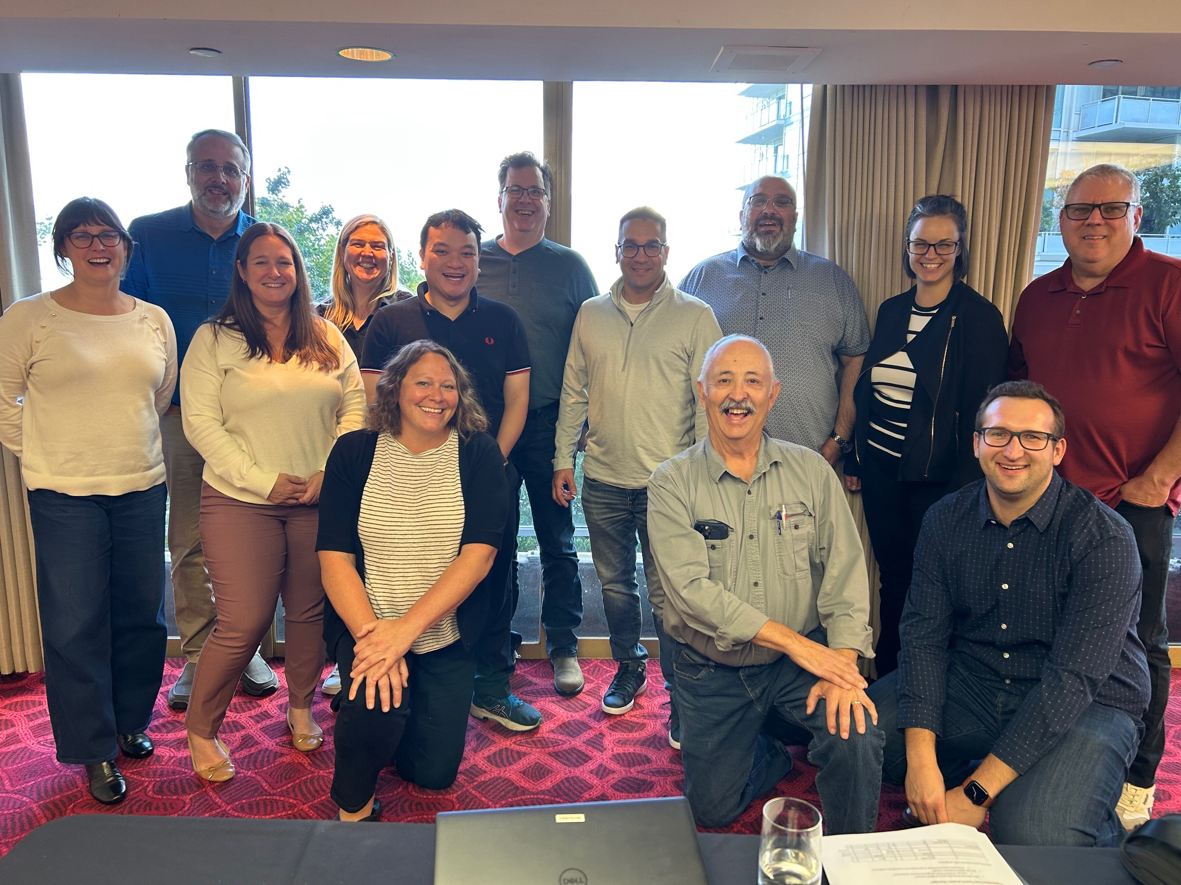
Face to Face Meeting
Once a year the Board of Directors meets to conduct one in person meeting.
In addition to two days of board meetings, we host a reception. In 2025 we met in Vancouver bringing together a wide array of occupational hygiene professionals, and OH students from UBC and BCIT, where we had record attendance and a lovely evening.
The CRBOH is planning the next in person meeting in October of 2026 in Halifax to coincide with the AIHA-APS technical sessions.

Slide 9
Key Accomplishments
Established volunteer committees for planning of the 2027 IOHA Scientific Conference in Montréal
Continued collaboration with strategic partners
Developed an examination preparation support page on website
Improved the application process for new candidates, including updates to the examination handbooks
Continued work on competencies, roles & responsibilities and written procedures for all roles within the organization

Slide 10
ONGOing Projects
Working with the 2027 IOHA Scientific Conference committees
Development of CSA standard for Occupational Hygiene management
Update and finalize the competencies, roles & responsibilities and written procedures for all roles within the organization to aim for the alignment of ISO 17024
Update of the CRBOH newsletter procedures
Development of the criteria for validating collegial and universities fast-track programs
Partnership with OHTA to expand CRBOH international reach

Slide 11
VICE PRESIDENT’S REPORT
(3:10-3:15 pm)
SUZANNE WILDE, ROH

Slide 12


Slide 13
IOHA2027
The Program
  PDCs and Technical Tours - Monday October 4
  Conference Sessions - October 5 – 8
  Ticketed Gala Event at Marche Bonsecours – evening of Wednesday October 6

Slide 14
2027 IOHA International Scientific Conference Committees
Committees Formed:
Conference Organizing Committee (COC)
Scientific Conference Content Committee (SCCC)
Local and Social Planning Committee (L&SPC)
Translation Committee (TC)
Exhibitor & Sponsorship Committee (E&SC)
Volunteer Committee (VC)
Thank you to our committee co-Chairs:
COC - Suzanne Wilde and René Leblanc
SCCC - Jérôme Lavoué and Victoria Arrandale
L&SPC - Kiet Nguyen and Guillaume Lachapelle
TC – Stéphane Archambault
E&SC - Dr. Chun-Yip Hon and Sarah McCurdy
VC – Alex Mercer and Leah McCormick

Slide 15

IOHA2027
Dates to Remember
  Portal for Sponsorships and Exhibitors – opened
  Portal for PDC abstract submissions – opens July 1, 2026
  Portal for Program Session abstract submissions – opens September 1, 2026
  Registration opens November 1, 2026
To sign up for IOHA2027 updates please visit:
IOHA2027.com

Slide 16
POLICIES & PROCEDURES
ISO 17024 – Conformity assessment – General Requirements for bodies operating certification of persons
The CRBOH intends to use internal audit practices as a constructive way of assessing compliance with policies, procedures, and practices, and to seek opportunities to improve our practices, tools and procedures.
This will be internally initiated to begin…once established, we may open it up to volunteers.

Slide 17
TREASURER’S
REPORT
(3:15-3:20 pm)
ALEX MERCER, ROH
ON BEHALF OF
KEVIN SCHMIDT, ROH

Slide 18
TREASURER’S REPORT - HIGHLIGHTS
The organization has consistently closed the year with a small profit at year end, and 2025 was no different. The statement of cash flows for 2025 is showing a drop in cash at year end as we continue to set aside seed money for the IOHA Scientific Conference. The organization is in a good financial position to host the conference in 2027.
The organization is seeing continued growth in the examination revenue stream due to government policy change, the modernization of the written examination process, and now the recently launched streamline application process.
Membership had been on a slight decline in past years, as we saw more retirees from the designation than new members. That trend has now reversed, membership numbers are increasing as there are more candidates for each exam than ever before, with record breaking numbers in Spring of 2026.
2025 In-person meetings and reception held in Vancouver hosted nearly one hundred attendees, including OH students from two programs in BC. These events, as well as collaboration with strategic partners, promotion and hosting of the scientific conference is expected to result in the continued growth of membership into the future.

Slide 19
TREASURER'S REPORT
ASSETS-Current | 2023 | 2024 | 2025
Cash and cash equivalents | $97,722 | $118,707 | $98,110
Short term investments | $96,034 | $85,880 | $87,880
Prepaid expenses | $1,693 | $1,874 | $36,951
TOTAL | $195,449 | $206,461 | $222,941
Statement of Financial Position
LIABILITIES -Current | 2023 | 2024 | 2025
Accounts payable and accrued liabilities | $7,245 | $6,524 | $7,392
Deferred Revenue (pre-paid dues) | $36,913 | $31,788 | $35,484
TOTAL | $44,158 | $38,312 | $42,876
NET ASSETS | 2023 | 2024 | 2025
Unrestricted net assets | $151,291 | $168,149 | $180,065
TOTAL ASSETS | $195,449 | $206,461 | $222,941

Slide 20
TREASURER'S REPORT
Statement of Revenue
REVENUE | 2023 | 2024 | 2025
Exam Fees | $13,700 | $14,400 | $22,600
Membership Dues | $75,625 | $75,050 | $76,500
Misc. Income (Sponsorship, Merch. Sales, Job Postings) | $4,078 | $10,253 | $8,560
Interest Income | $2,604 | $2,210 | $2,591
Total Revenue | $96,007 | $101,913 | $110,251
Statement Of Operations
Expenses | 2023 | 2024 | 2025
Total expenses | $78,738 | $85,055 | $98,335
Difference between revenues and expenses | $17,268 | $16,858 | $11,916

Slide 21
INDEPENDENT AUDITOR’S REPORT
To the Members of Canadian Registration Board of Occupational Hygienists:
Opinion
We have audited the financial statements of Canadian Registration Board of Occupational Hygienists (the
Organization), which comprise the statement of financial position as at December 31, 2025, and the statement
of operations and net assets and statement of cash flows for the year then ended, and notes to the financial
statements, including a summary of significant accounting policies.
In our opinion, the accompanying financial statements present fairly, in all material respects, the financial
position of the Organization as at December 31, 2025, and its financial performance and its cash flows for the
year then ended in accordance with Canadian accounting standards for not-for-profit organizations.
* The full audited financial statements are available to be viewed by contacting our Secretariat.

Slide 22
MOTION TO APPROVE 2025 AUDITOR’S REPORT
Motion to approve 2025 Audit
Second to approve 2025 Audit

Slide 23
MOTION TO APPOINT SCARROW & DONALD FOR THE 2026 AUDIT
Motion to appoint Auditor for 2026
Second to appoint Auditor for 2026

Slide 24
REGISTRAR’S
REPORT
(3:20-3:25 pm)
ALTAIRA HILDEBRAND, ROH

Slide 25
2025-2026 Focus: Strengthening the Registration, and Examination Processes
Enhancements to the online written examinations
      Improved exam setup, candidate onboarding, and post‑exam reconciliation based on lessons from recent cycles
      Reduced administrative burden for exam chairs while improving the candidate experience
      Introduced new volunteer role: Exam Systems Liaison (Ken Major)
New online application system
      Streamlines the full registration workflow
      Reduces errors and automates manual steps
      Integrates applicants directly into membership and certification systems
      Improves status tracking, processing times, and transitions from application → exam → certification → maintenance
Notes:
Over the past year, the CRBOH Registrar’s office has advanced several key initiatives
that strengthen the organization’s registration, certification, and examination processes.
Registration activity has grown, with a noticeable increase in both ROH and ROHT
applications. This rise reflects broader interest in professional credentialing within
occupational hygiene in Canada.
An area of focus has been improving the use of the online written examination system.
Building on lessons learned from recent exam cycles, we have overseen improvements
to exam setup, candidate onboarding, and postexam reconciliation. With each cycle we
strive to reduce administrative burden and improved the overall candidate experience. A
new volunteer role ‘Exam Systems Liaison’, held by Ken Major, has been introduced to
support and optimize the use of the online testing platform. Ken’s contributions include
technical oversight to enhance the exam functionality while reducing exam chairs
administrative time, system troubleshooting, and helping ensure consistent exam
delivery across sessions, strengthening the reliability, statistical analysis and scalability
of the system.
Looking ahead, we are preparing to launch a new online application system that will
streamline the registration workflow. This platform will reduce opportunities for error,
automate several manual steps, and integrate applicants directly into CRBOH’s
membership and certification management systems. Once implemented, it will provide
clearer status tracking for applicants, faster processing times, and a more seamless
transition from application to examination, eventual certification and into maintenance.
Together, these developments reflect a sustained commitment to operational
excellence, technological modernization, and improved service to current and future
CRBOH professionals. A big thanks to our volunteers - we couldn’t do it without them
(Board members and Written &amp; Oral exam committee members) and our Secretariat
Leah.

Slide 26
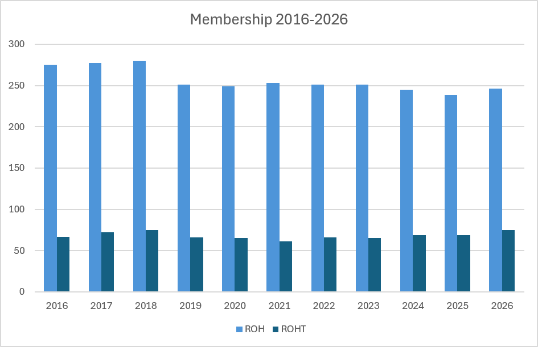
Membership Ten Year Review
We are seeing an increase in membership primarily in the ROHT designation with significant increases over the past two years.
Note: membership is the total of new members and renewals
Notes:
ROH membership declined gradually from 280 (2018) to 239 (2025) before rebounding slightly to 246 in 2026.
ROHT membership has grown steadily, rising from 72 in 2016 to 87 in 2026, with notable increases in the last three years.

Slide 27


CURRENT ROH MEMBERSHIP
International: 9
3
33
36
8
28
2
112
5
11
Total ROH: 247

Slide 28
CURRENT ROHT MEMBERSHIP
International: 2
1
3
12
57
2
6
1
6
1
3
Total ROH: 109

Slide 29

EXAMINATION TYPES
ROH Path Options
ROHT Path Options
Regular
Multiple choice, essay and oral exam
Fast Track
Phase 1: Multiple choice within three years of eligible Masters program
Phase 2: Essay and oral exams
NAR
Oral
Multiple choice and essay exam
Approximate average pass rates for ROH is 65%
ROH Regular: 45%
ROH Fast Track phase 1: 60%
ROH Fast Track phase 2: 91%
ROH NAR: 67%
Average pass rate for ROHT is: 67%
NAR: National Accreditation Recognition

Slide 30
New ROH Members - 2025
Jordan Cabral
Pietro Gasparrini
Meriem Bessadet
Mazen Bou Diab
Nancy Wilk
Dylan Mclaughlin
Susan (Xin Nuo) Bai
Jaap Aulakh
Waleed Essam Mostaffa
Matthew Olota
Craig Maunder
Anick Berube
Melanie Chown
Romain Mathevet
Mitchell Trickett
Congratulations and welcome to the CRBOH!

Slide 31
New ROH Members - 2026
Laurent Groux
Muhammad Qazi
Sarah McCurdy
Zainab Mustafa
Meghan Brady
Sayoojya Saju
Ebenezer Opoku-Ware
Rachel Pinto
Congratulations and welcome to the CRBOH!

Slide 32
New ROHT Members - 2025
Dustin Jensen
Kyle Holland
Connor Bray
Kevin Simpson
Logan Hall
Nicole Dunsmore
Thomas Hammerton
Raymond Leckie
Justin Ziebart
Shane Dooley
Khalid Al-Subhi
Emily Hagan
Adhirajsingh Inderjeet
TJ McKeough
David Bezemer
Congratulations and welcome to the CRBOH!

Slide 33
New ROHT Members - 2026 YTD
  Aden Yusuf
Hercie Barnsdall
Sheena Maxwell
Kris (In Sung) Jeon
Nicole Pearson
Kendra McNabb
Lucas Sheptycki
Amy Kadwell
Stephen Barrett
Ben Bradshaw
Jessica Freeland
Rachelle Geere
Arthur Lalog
Matthew Maltby
Sandra Marcoux
Steeve Théberge
Gary Trias
Valerie Villeneuve
Vincent Roch
Rebecca Swanson
Joshua Campbell
Raianne McNeill
Congratulations and welcome to the CRBOH!

Slide 34
Recently Retired Members
  ROH
Claude Larivière
Nat Fortin
Carl Woychuk
Margaret Fung
Dan Curts
Ilma Bhunnoo
John Sommerville
Malcolm Morris
Mike Grey
  ROHT
Corry Devos
Rachelle MacEachen
Congratulations on your retirement!

Slide 35
COMMITTEE REPORTS
(3:20-3:40 pm)

Slide 36
EXTERNAL AFFAIRS REPORT
Alex Mercer, ROH Matthew Brewer, ROHT Suzanne Wilde, ROH

Slide 37
EXTERNAL AFFAIRS
ONGOING INITIATIVES
NAR Process
Completed and planned re-recognition reviews for multiple organizations
Reviewed and supported both new applicants
Appointed a new Chief Reviewer and progressed leadership succession planning
Maintained regular monthly meetings (except July) to coordinate work and share updates
Continued coordination with member associations to ensure consistency and standards
Identifying gaps in internal programs
Helping our organization by transferring knowledge from other international organizations

Slide 38
EXTERNAL AFFAIRS
ORGANIZATIONAL OUTREACH
Canadian Occupational Health & Safety Professions Alliance/Alliance canadienne des professions de la santé et de la sécurité au travail (COHSPA/ACPSST)
- Six leading Canadian organizations focused on occupational health and safety (OHS), occupational hygiene, and ergonomics have come together to explore enhanced collaboration.
- These organizations are the Association of Canadian Ergonomists (ACE), the Board of Canadian Registered Safety Professionals (BCRSP), the Canadian College for the Certification of Professional Ergonomists (CCCPE), the Canadian Registration Board of Occupational Hygienists (CRBOH), Health and Safety Professionals Canada (HSPC), and the Occupational Hygiene Association of Ontario (OHAO).
Visit the website at: https://cohspa-acpsst.ca/en/
Connect on LinkedIn at: (20) COHSPA/ACPSST: Posts | LinkedIn
This year COHSPA:
- Developed website and LinkedIn page, began communications on both platforms
- Filmed an educational video aimed at the public featuring representatives from the three professions (safety, OH, ergo) at the BCRSP 50th Anniversary conference
- Had second in-person meeting at the BCRSP 50th Anniversary conference

Slide 39
EXTERNAL AFFAIRS
ORGANIZATIONAL OUTREACH
Board of Canadian Registered Safety Professionals (BCRSP)
Alberta Society of Health and Safety Professionals (ASHSP)
- Continue to support the bid to gain professional regulation of Safety and Hygiene professionals in the province of Alberta (title and scope protection) through the development of a regulatory college.

Slide 40
COMMUNICATION & PROMOTIOn
REPORT
Brad Schmermund, ROH

Slide 41
COMMUNICATION & PROMOTION REPORT
Activities
Newsletter Committee was restructured to create a more streamlined approach which will allow for 3 newsletter cycles a year with reduced volunteer hours. This resulted in missing the standard Fall newsletter cycle. Restructure changes included combining editor role with Secretariat role, and adjustments to translation committee workflows
Explored options for digital badges and certificates. Decision to pause, as it is currently a low value item for members and restart these projects post-2027 IOHA conference
Increased collaboration and engagement with local OH member associations across Canada such as AIHA local sections / OHAO
Selected 2026 recipients of Lifetime Achievement Award and Student Award
Committees stood up to increase clarity of ROH and ROHT competency frameworks, to allow for better communication of OH areas of competence to support regulators and communicate value to employers.

Slide 42

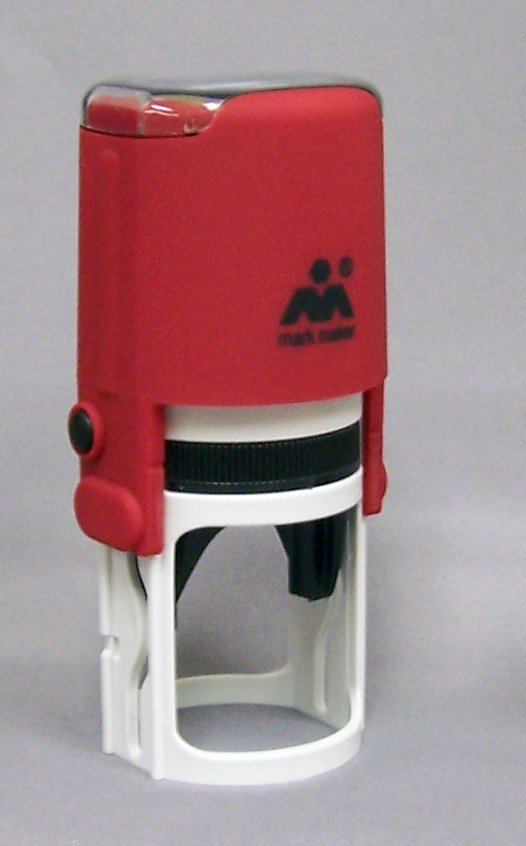

CRBOH Merchandise
Custom frames, self inking stamps and seal embossers continue to be available on the website for purchase.
Are there items you’d like to see CRBOH release for member or promotional purposes? Email any board member or secretariat@crboh.ca
Notes:
Order from CRBOH website; self inking stamp $50 + HST; embosser seal $65 = HST; replacement ink pads $$7.99 shipping $16

Slide 43
COMMUNICATION & PROMOTIONS REPORT
Volunteer Recognition
Thank you to our newsletter committee and article contributors
Translators:
David Belisle
Véronique Maynard
Meghan Friesen
Laure-Elise Forel
Mathilde Dulude
Stéphane Archambault
Members & Contributors:
Glyn Jones
Ted Letourneau
Suzanne Wilde
Altaira Hildebrand
Kiet Nguyen

Slide 44
ROH & ROHT EXAM COMMITTEE REPORTS
Suzanne Wilde, ROH

Slide 45
ROH & ROHT EXAM COMMITTEE REPORTS
EXAMINATION COMMITTEES
Written Exam Chairs: Victoria Arrandale (ROH COMMITTEE) Dave Jarrell (ROHT COMMITTEE)
Chief Oral Examiners: Andrea Sass-Kortsak, Guillaume Lachapelle, Lydia Renton
BOD Liaison: Suzanne Wilde
Online Examination Support: Ken Major

Slide 46
ROH EXAM (WRITTEN) COMMITTEE REPORT
2025 - 2026 COMMITTEE MEMBERS
Victoria Arrandale
Anick Bérubé
Chris Fraser
Matthew MacFarlane
Niclas Manson
Nicolas Millot
Shamini Samuel
Robin Van Driel
Online written examinations were held in October 2025 and April 2026.

Slide 47
ROH EXAM (ORAL) COMMITTEE REPORT
CHIEF ORAL EXAMINERS (COE):
Andrea Sass-Kortsak, Lydia Renton, Guillaume Lachapelle
Each ROH oral exam panel includes at least one Chief Oral Examiner
For international candidates, the ROH oral exam panel consists of the 3 COEs

Slide 48
oral exam panel members
COE – Andrea Sass-Kortsak, Lydia Renton, Guillaume Lachapelle (at least one of) PLUS 2 panel members:
Toronto & Ontario - Yang Ting Shek, Rosemary Mandatori, Derrick Chung, Letty Wong
Montréal & Québec & Atlantic - Stéphane Archambault, Capucine Ouellette, René Leblanc
Central and Western Canada - Tiffany Clayton, Dave Keenan, Evan Alvernaz

Slide 49
ROHT EXAM COMMITTEE REPORT
2025 – 2026 COMMITTEE MEMBERS
  Nancy Fedyniak
  Ronald Ng
  Brad Studham
  Matthew Brewer
  Guillaume Lachapelle
  Nicolas Millot
Chair: Dave Jarrell
BOD Liaison: Suzanne Wilde

Slide 50
EXAM COMMITTEE REPORT
Volunteer Recognition
Thank you to all our committee volunteers
And a special thanks to our committee Chairs
Your work is much appreciated!

Slide 51
REGISTRATION MAINTENANCE & POINTS
COMMITTEE REPORT
CHAIR: JODI JOHNSON, ROH
BOD LIAISON: BRAD SCHMERMUND ON BEHALF OF ROBERTO SGROSSO, ROH

Slide 52
REGISTRATION MAINTENANCE & POINTS REPORT
ROH – CYCLE END DATE 2025
ROHT – CYCLE END DATE 2025
Worksheet Status | Total
Complete | 16
In Review | 27
Not submitted | 21
Grand Total | 64
Worksheet Status | Total
Complete | 2
In Review | 3
Not submitted | 2
Grand Total | 7
* As of June 8, 2026

Slide 53
REMINDERS
In response to the need to attract and retain volunteers, beginning in 2025, all CRBOH volunteer work has doubled in annual RM points, with no cap in points. Committee Members will receive 2 points annually. Chairs (and similar roles) will receive 3 points annually.
Starting in 2026, a 2-hour ethics course is required as part of the maintenance cycle. Ethics courses relating to health & safety or other science professional designation (i.e. engineering; chemistry; etc.) will be acceptable.
CRBOH is in discussion to allot points for any members who volunteer for the 2027 IOHA Conference in Montréal, specific to the Conference. Attendees to the conference will also be eligible for RM points.

Slide 54
REGISTRATION MAINTENANCE & POINTS REPORT
Volunteer Recognition
Thank you to our committee member volunteers:
ROH: Anjie Davis, Krista Thompson, Mike Grey
ROHT: Matthew Brewer, Ronald Ng, Kathy Rohl
We appreciate all your hard work!

Slide 55
FUTURE OF THE PROFESSION
REPORT
Joey Bellino, ROH

Slide 56
HIGHLIGHTS
Committee published “What An Occupational Hygienist Can Do For A Workplace” document.
Work continues on updating and promoting title/scope protection presentations and other promotional presentations.
Provides content for LinkedIn posts promoting the occupational hygiene profession
Exploring options for committee members to make presentations at schools and conferences.
Continue discussions with stakeholders and key partners in the industry.

Slide 57
FUTURE OF THE PROFESSION
Volunteer Recognition
Thank you to all our committee volunteers
Beth Higgins
Sarah McCurdy
Your work is much appreciated!

Slide 58
Awards
Presented By
Brad Schmermund, ROH

Slide 59

MARC COUSINEAU
Student Award
Congratulations to our 2026 recipient!
  Kiana Bonamin
Enrolled in Occupational and Environmental Hygiene(OEH) M.Sc. program
  University of British Columbia

Slide 60
Andrea Sass-Kortsak
Lifetime Achievement Award
In honour of extensive and excellent contributions to the profession of occupational hygiene at a provincial, national and international level.

Slide 61
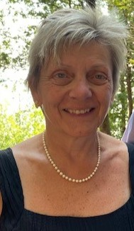
2026 RECIPIENT
Lydia Renton, ROH

Slide 62
Certification/Registration: A Professional Success Story
CRBOH AGM, 11 June 2026
Lydia Renton, B.Sc., CIH, ROH, FAIHA
EVP, BluMetric Environmental Inc.

Slide 63
Topics
1
Career Path
2
Volunteer Positions
3
Opportunities
4
Professional Accreditation – Why?

Slide 64
Career Path: Quick Resume
1977
Graduated B.Sc. (Chemistry) from University of Ottawa
1977–1981
Labour Canada – Industrial Hygiene Technician
1981–1985
Health Canada – Industrial Hygiene Technologist
1985–1989
Ontario Ministry of Labour – Occupational Hygiene Consultant; A/Manager Eastern Ontario Region
1989–1999
Bell-Northern Research – Corporate Occupational Hygienist;
Nortel Semiconductors – EHS Manager and Senior Occupational Hygienist
1999–Present
Manager, then Director and Partner, and now EVP, Occupational Hygiene, Safety & Security, BluMetric Environmental Inc. (formerly WESA Group)

Slide 65




Career Path: (Partial) Volunteer Positions
1993-2015?
Ottawa High Tech Safety Association (not formal association)
2001-2004 & ongoing
CRBOH, Board of Directors and Chair; co-Chief ROH Oral Examiner
2009–2014
ABIH, Board of Directors and Chair
2011 - ongoing
WHWB – Workplace Health Without Borders – member; Board of Directors; member
2009–Present
OHTA – Occupational Hygiene Training Association – Advisory Council; volunteer trainer; Advisory Committee
2017–Present
WSN – Workplace Safety North – Board of Directors; Chair of Board; current Director

Slide 66
Pathways
01 Lack of local training
Figure it out, read about it, use NIOSH methods, take the training (later)
02 IH Technician / Technologist
Pathway in Canadian government — Get the CIH!
03 Networking in Ottawa
Co-founder of SHEPN (Safety, Health & Environmental Professional Network)
04 I am Canadian
Get the ROH!
05 Question ‘why’ in an organization
Led to Board of Directors in OHSAgency (1990-92) & President CRBOH; ROH Exam Committee
06 Recognized in Ontario
Hugh Nelson Award of Excellence, 2008
07 International work, starting 1999
Mexico, Mongolia, Kyrgyzstan, China, France, Czech Republic, Tanzania, Turkey
08 Elected to the ABIH (now BGC)
American Board of Industrial Hygiene, 2009–2014 Chair 2012-13 (1st Cdn in 50 years)
09 WSN Board of Directors and Chair 2017–present
10 WHWB Board of Directors and Volunteer
Say YES to opportunities!
OPPORTUNITY & PREPAREDNESS

Slide 67
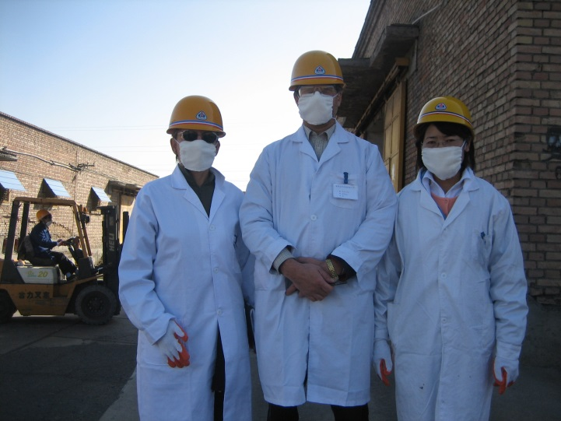
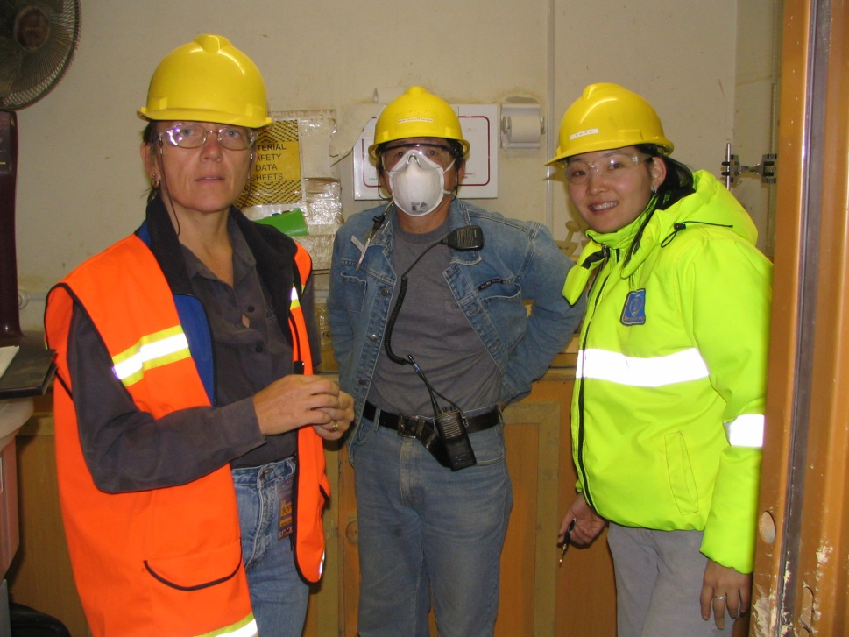
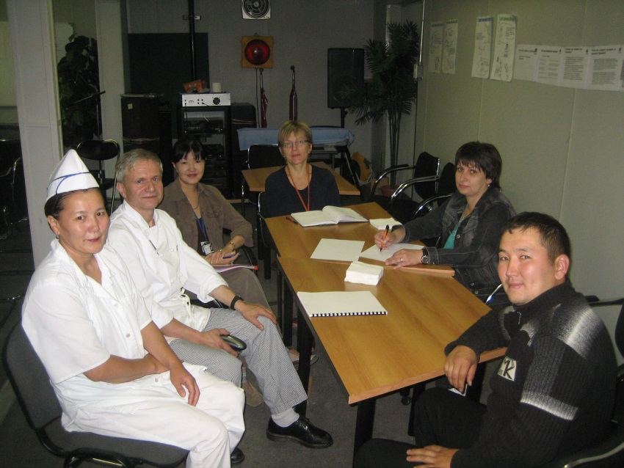

IH Training, Mongolia, Nov 2005
CN Shipment, Oct 2006
Food Hygiene Safety, June 2008
AIHA Asia Pacific, Singapore, Oct 2013

Slide 68
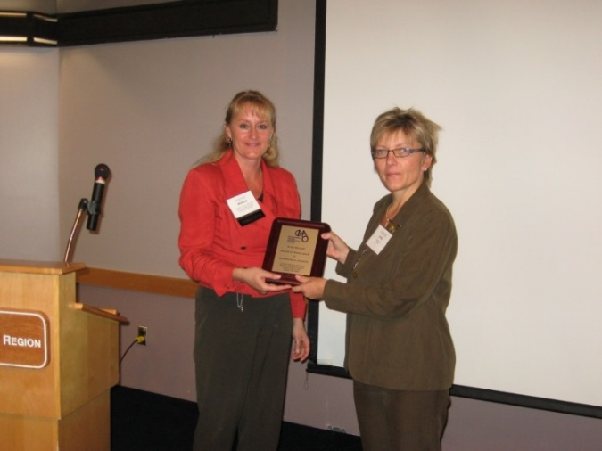
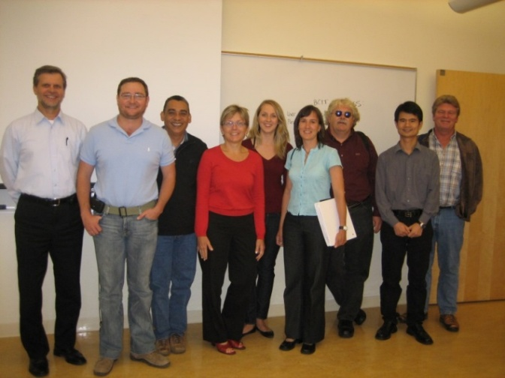
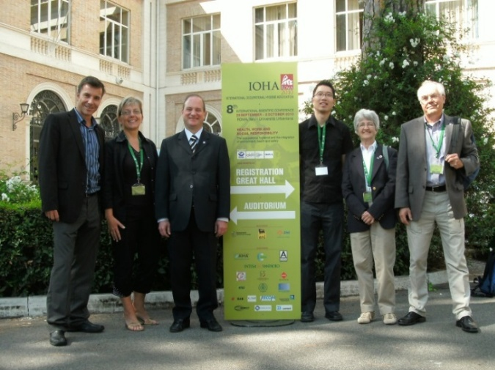
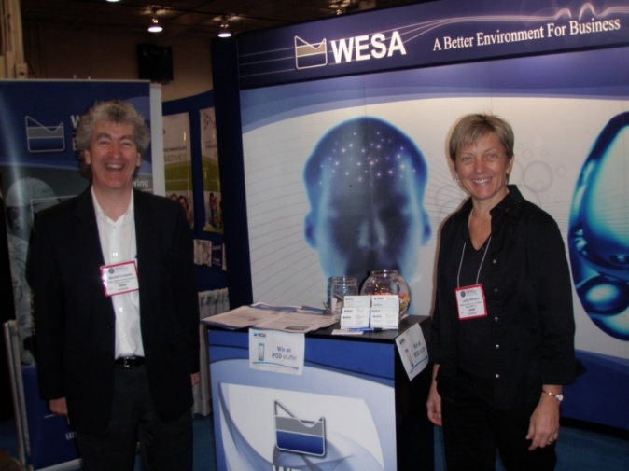
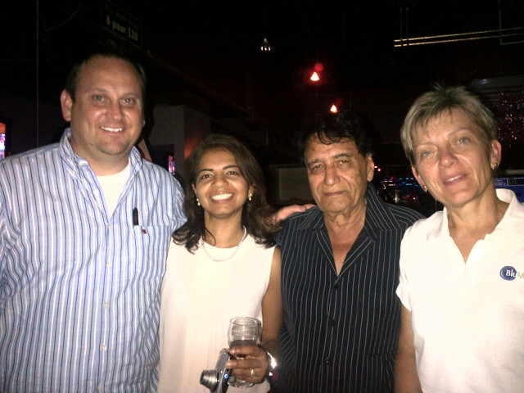
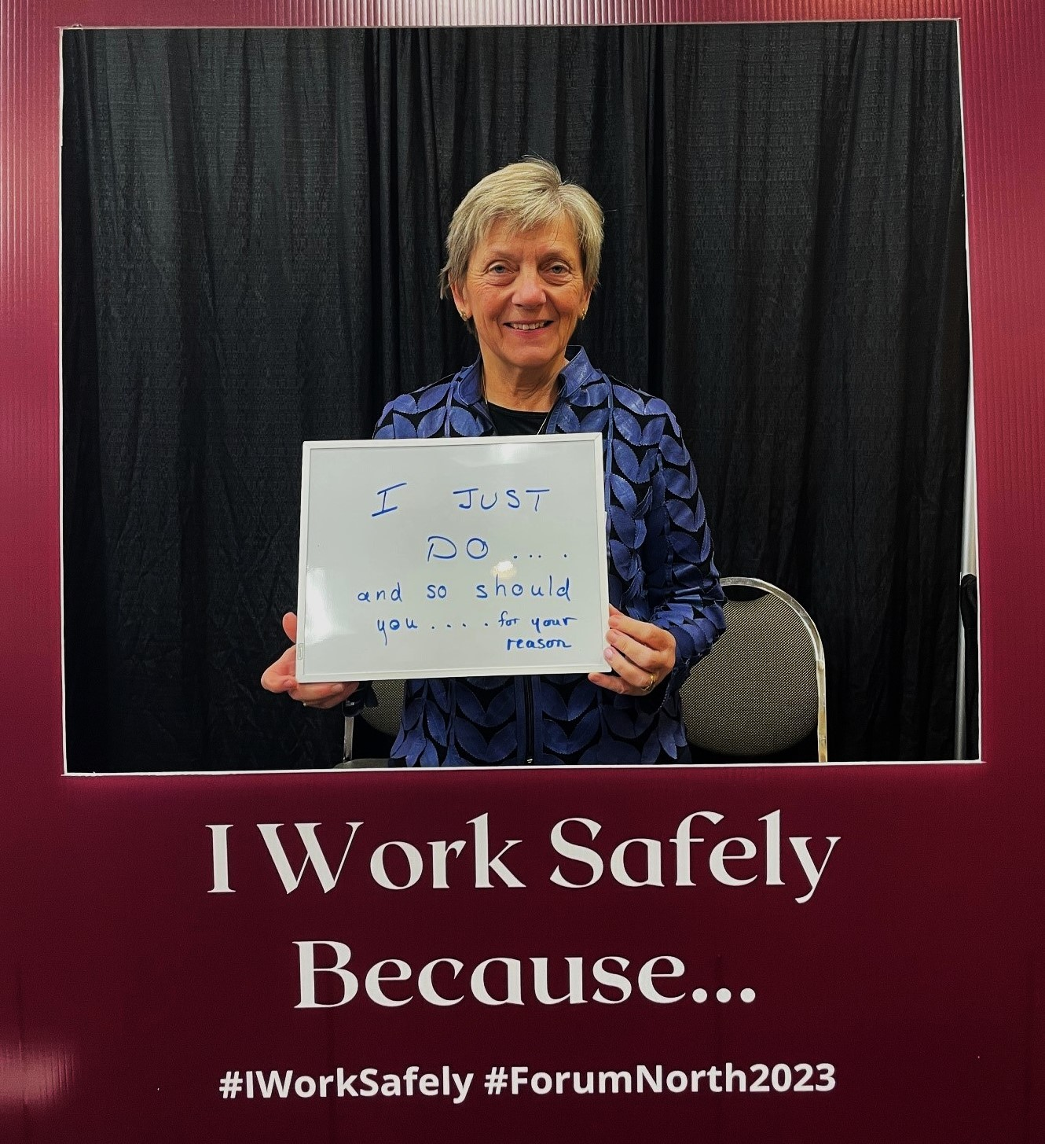
OHAO Hugh Nelson Award, 2008
Cyanide Course, Vancouver,
Sept 2008
IOHA, Rome, Sept 2010
Partners in Prevention Conf May 2010
AIHce13, Montreal

Slide 69
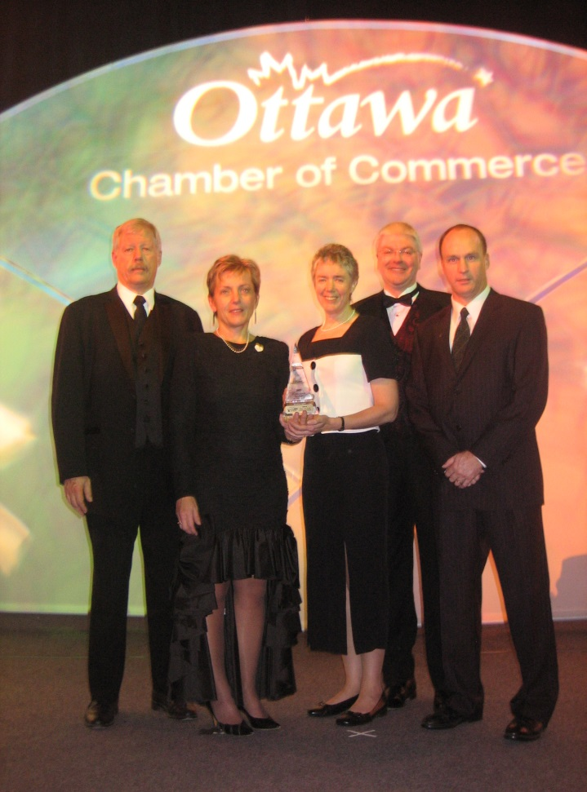

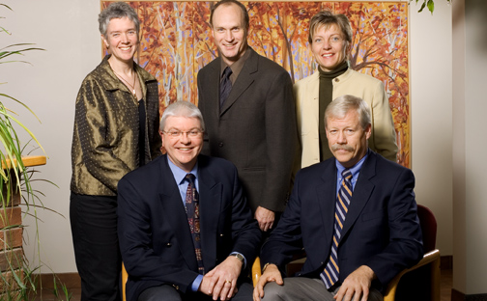
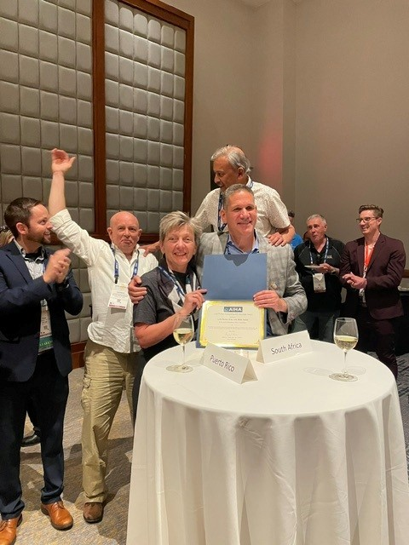
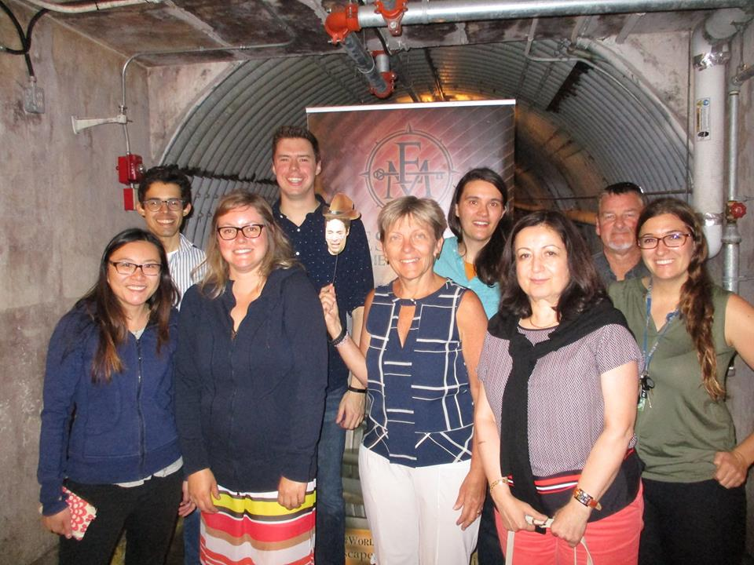
Professional Services Business of Year 2006
BluMetric IH/OHS Escape Room Diefenbunker July 2017
AIHce 2023 International Affairs Committee 2023

Slide 70
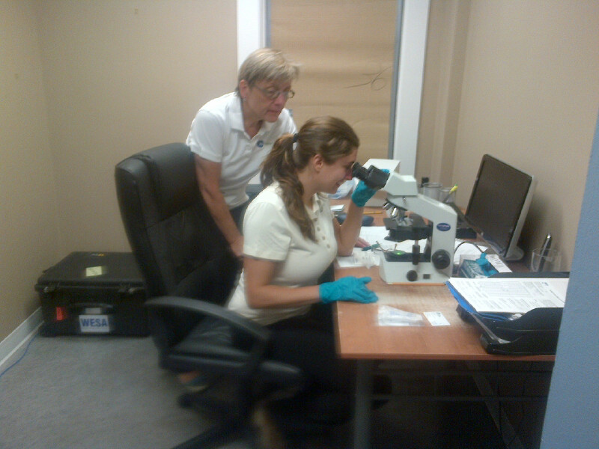
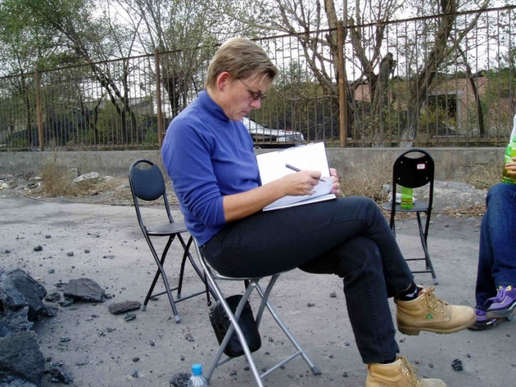
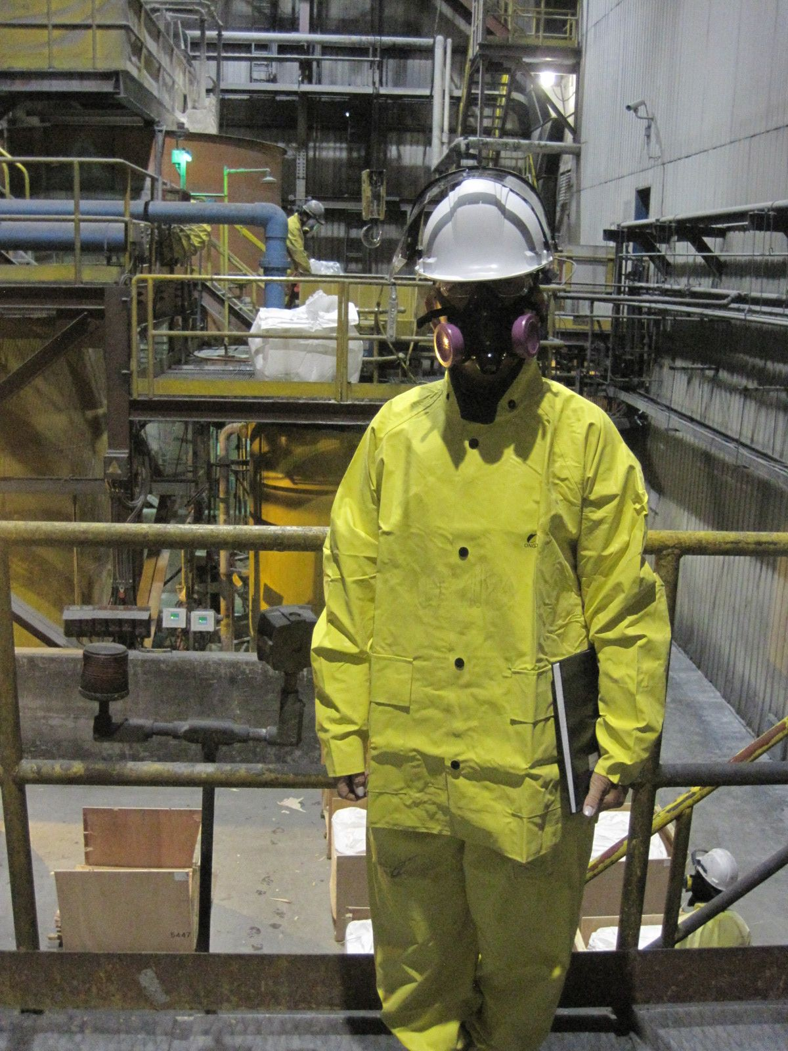
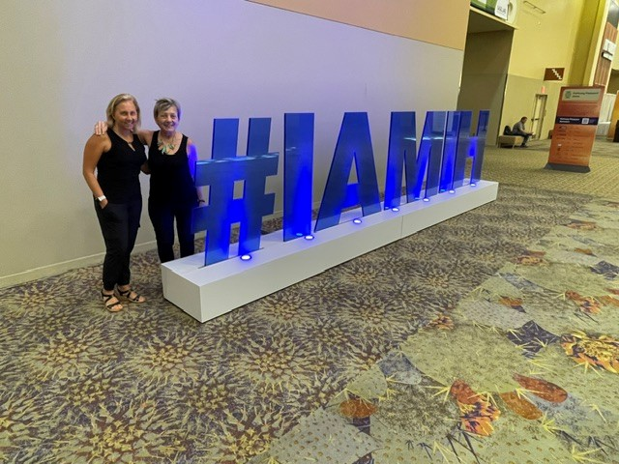
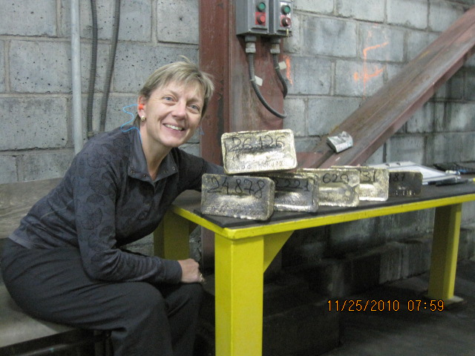
Where I like to be……
Asbestos Lab Yellowknife July 2013
Gap Analysis/Auditing
CN Code Gold Mining Audits US $4.3 M

Slide 71








Slide 72
OTHER BUSINESS (3:50-3:55 pm) incoming president
Kiet Nguyen, ROH

Slide 73
INCOMING PRESIDENT
Suzanne Wilde, ROH
2026 - 2027
Suzanne has served on the CRBOH Board since 2021 as the ROH Director representing Ontario. She has made significant contributions, including Board Liaison of the Examination Committee, CRBOH representative on the Board of IOHA, and most recently Co-Chair of the IOHA2027 Conference Organizing Committee.
Suzanne Wilde has a master’s degree in Occupational Health from McGill University and her professional designations include a Registered Occupational Hygienist, Certified Industrial Hygienist, Canadian Registered Safety Professional, Certified Safety Specialist, and Certified Health and Safety Management Systems Auditor. She has over 22 years' experience in the occupational health, safety and hygiene field.
The Board extends its sincere congratulations to Suzanne on this appointment and looks forward to her leadership in advancing the mission and values of the CRBOH.

Slide 74

INCOMING ROH DIRECTOR, ONTARIO
Krista Thompson, ROH
2026 - 2029
Krista Thompson received her ROH in 2010, and has been working in the field of occupational hygiene and safety since 2007. Krista has also a CRSP designation. She is a graduate of the University of Toronto’s Occupational and Environmental Health program, and her undergraduate degrees are from Queen’s University. Krista has experience in the consulting sector, and has worked in the oil & gas, pharmaceutical, and healthcare sectors. She’s currently an occupational hygienist at the Occupational Health Clinics of Ontario Workers (OHCOW) focusing on retrospective exposure assessments. Krista has been a volunteer with CRBOH since 2016, volunteering with both the Newsletter and Maintenance Points Committees. Krista is so excited to work with the CRBOH as a Board Member.
The CRBOH is excited to welcome Krista to the Board of Directors and looks forward to working with her in advancing the mission and values of the CRBOH.

Slide 75

INCOMING ROHT DIRECTOR,
Canada - west
Ibrahima Camara, ROHT
2026 - 2029
Ibrahima (Abe) Camara is a Registered Occupational Hygiene Technologist (ROHT) with more than 13 years of experience in occupational health, safety, industrial hygiene, and environmental risk management across construction, utilities, industrial, and mining sectors. He holds a diploma in Occupational Hygiene from Alison College.
He has extensive expertise in exposure assessment, occupational hygiene programs, silica and noise monitoring, hazardous materials management, and HSE leadership. Throughout his career, he has contributed to strengthening workplace health and safety systems while promoting regulatory compliance, worker well-being, and operational excellence.
Ibrahima is passionate about building a strong safety culture, developing people, and fostering environments where everyone goes home healthy and safe.
In addition to his professional work, he is actively involved in community leadership and youth development initiatives. He values collaboration, integrity, continuous improvement, and supporting programs that positively impact families and communities. Fluent in both French and English, Ibrahima effectively works across diverse professional and multicultural environments.
The CRBOH is excited to welcome Ibrahima to the Board of Directors and looks forward to working with him in advancing the mission and values of the CRBOH.

Slide 76
MANY THANKS FOR YOUR HARD WORK & CONTRIBUTIONS TO CRBOH and THE BOARD of directors
OUTGOING DIRECTORS
Kevin Schmidt, ROH
ROH Director for Ontario
Brad Schmermund, ROH
ROHT Director for Central & Western Canada

Slide 77
Q & A (3:55-4:00 pm)
Please use the chat function if you have a question
Questions can also be emailed to our Secretariat and will be responded to very soon!

Slide 78
MOTION TO ADJOURN THE CRBOH 39th ANNUAL GENERAL MEETING
Motion to adjourn

Slide 79
WE WILL NOW TAKE A 5 MINUTE BREAK
UP NEXT:
Presentation
Leadership Driven Excellence -Transformational Leadership Drives H&S Excellence
WITH GUEST SPEAKER:
Richard D. Fulwiler, ScD, CIH - Retired, FAIHA

Slide 80
Leadership Driven Excellence -Transformational Leadership Drives H&S Excellence
Instructor - Harvard T.H. Chan School of Public Health
President - Transformational Leadership Associates
Retired Director - Health and Safety Worldwide, Procter & Gamble
Dr. Richard D. Fulwiler is President of Transformational Leadership Associates, a consultancy that focuses on organizations achieving functional excellence by applying the principles of transformational leadership.
Prior to forming Transformational Leadership Associates, he had a 28 year career in health and safety at Procter & Gamble starting as an industrial health engineer and progressing to Director of Health and Safety Worldwide.
Rick has a faculty appointment at the Harvard School of Public Health where he is co-director for their Leadership and Management course for EHS Professionals. He has an international reputation and has published widely and is a frequent speaker at conferences. He has been listed as one of the five gurus in EHS Today’s list of the 50 most influential leaders in Environment Health.
He is past President of the American Academy of Industrial Health (AIHA). He has been an officer of the American Industrial Health Association and a member of its Board of Directors.

Slide 81
Leadership Driven Excellence -Transformational Leadership Drives H&S Excellence
Transformational leadership is the key to engaging the workforce be it management or shop floor workers. Engagement is the key to achieving functional excellence be it in cost, quality, production, safety or other key performance indicators. Characteristics describing both transactional and transformational leadership will be presented. Five critical characteristics of transformational leadership will form the basis for growing one’s transformational leadership skills. The presentation will include some participant interaction and conclude with a transformational leadership self and organizational assessment.

